Slide 1


PYTHON FOR DATA ANALYSIS
PROJECT
SARA THIBIERGE - HENRI SERANO - ELOI SIEDLITZ
30/11/2023

Slide 2

SUMMARY
DATASET PRESENTATION
IMPORTED LIBRARIES
GENRE PREDICTION MODEL
DATA VISUALISATION
DATA STATISTICS
STREAMLIT

Slide 3

SPOTIFY DATASET : PRESENTATION
Top Used Columns:
name: The name of the song.
artists: The artists associated with the song.
country: The country associated with the song's performance.
popularity: The popularity level of the song.
is_explicit: Indication of explicit content.
duration_ms: The duration of the song in milliseconds.
danceability, energy, acousticness, instrumentalness: Measures of the song.
energy: Measure of the song's energy.
key: The primary key of the song.
loudness: The loudness of the song.
valence: The positivity of the song.
Objective: Analyze music trends based on these
attributes to understand listener preferences.

Slide 4

SPOTIFY DATASET : LIBRARIES
Imported Libraries
Pandas & NumPy: Used for data processing.
SciPy: Used for statistical calculations.
Streamlit: Web application framework for interactive data visualization.
scikit-learn: For data preprocessing and machine learning.
Folium & streamlit_folium: For mapping.
Plotly & Bokeh: For interactive visualizations.
JSON & OS: For file management and environmental configuration.
set_page_config: Layout configuration for a wide display, suitable for extensive visualizations.

Slide 5
PREDICTION MUSIC GENRE
1. Lack of Genre Information:
Due to the absence of genre information (rock, country, jazz) in the dataset, we embarked on predicting genres.
2. Utilizing Spotify API: (spotify_API_request.py)
Leveraged the Spotify API to fetch genre-specific playlists (e.g., rock, country, jazz).
Transformed playlist data into CSV format for analysis.
3. Feature-Based Prediction:
Utilized the playlist dataframes to predict the genre of each song based on its features (danceability, energy, tempo, etc).
4. Choice of Classifier:
Employed the Random Forest Classifier for genre prediction.
The Random Forest Classifier was chosen for its ability to handle diverse features, reduce overfitting, and provide robust predictions.

Slide 6
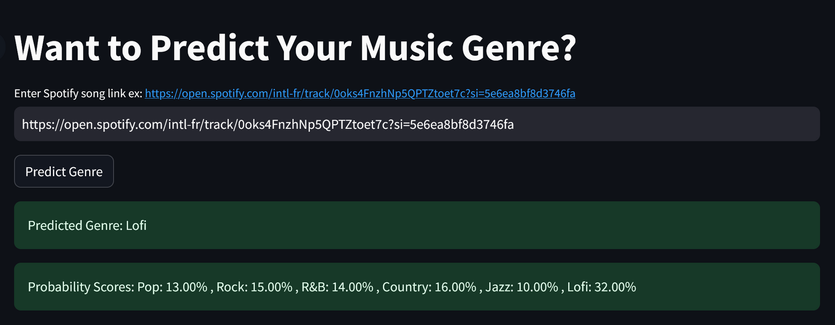
PREDICTION MUSIC GENRE
We did it with six genres:
Pop, Rock, Country, R&B, Jazz, Lofi
The accuracy score we obtained for this model was 74%
as for the classification report the precision for each genre was around 70%
We created a function, track_id_from_uri, which extracts the song ID from its URL, simplifying the testing process.

Slide 7
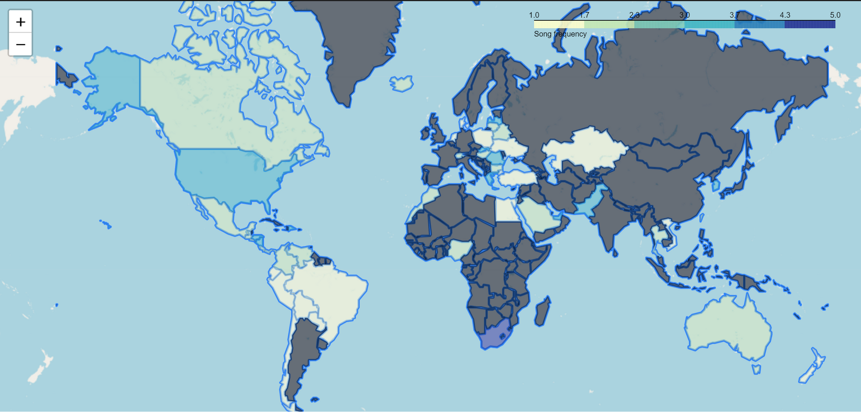
DATA VISUALISATION -FOLIUM MAP
Geographical Distribution of Music Origins by Country
(Graphs may be more perceptible in the notebook due to their interactive nature.)

Slide 8
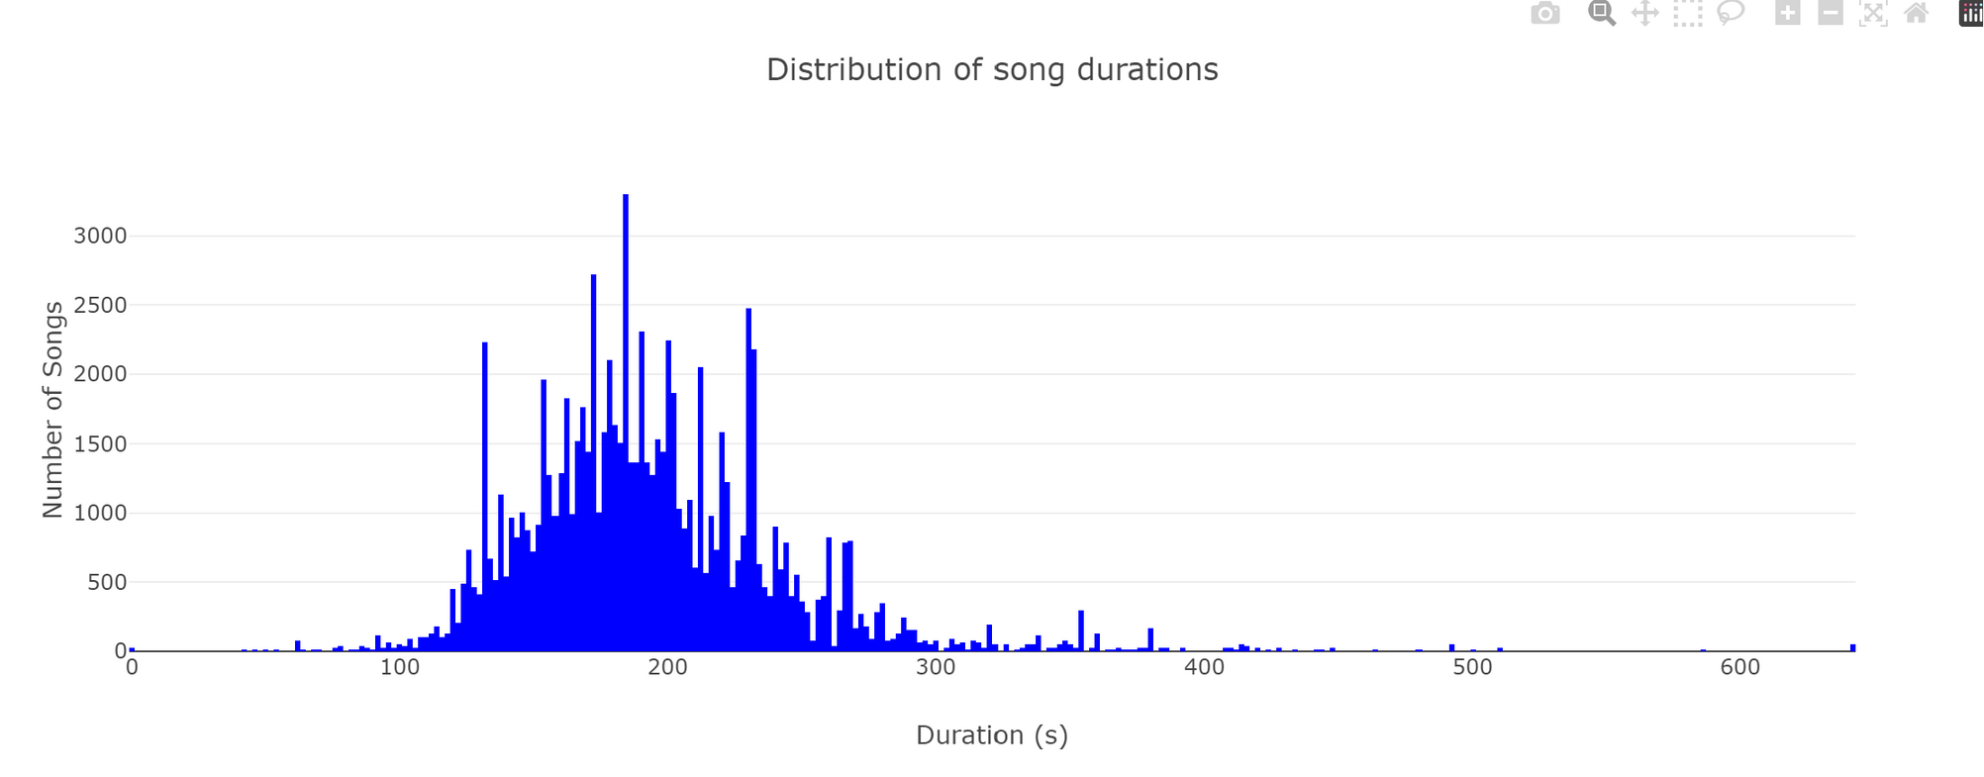
DATA VISUALISATION
Histogram - Distribution of song durations
We can see that the mean duration of musics is 194.52 seconds. Which represent 3 minutes and 14s.

Slide 9
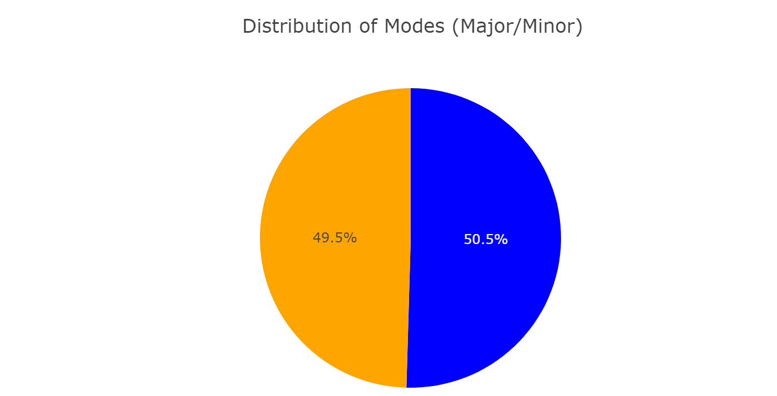
DATA VISUALISATION
Pie Plot - Distribution of Modes (Major/Minor)
We can see that the musics are equaly minor or major.
In music theory, the terms "minor" and "major" refer to two of the most common tonalities.
Major Key:
Music in a major key is characterized by a bright, happy, or positive sound.
Minor Key:
Conversely, music in a minor key has a darker, sadder, or more introspective quality.

Slide 10
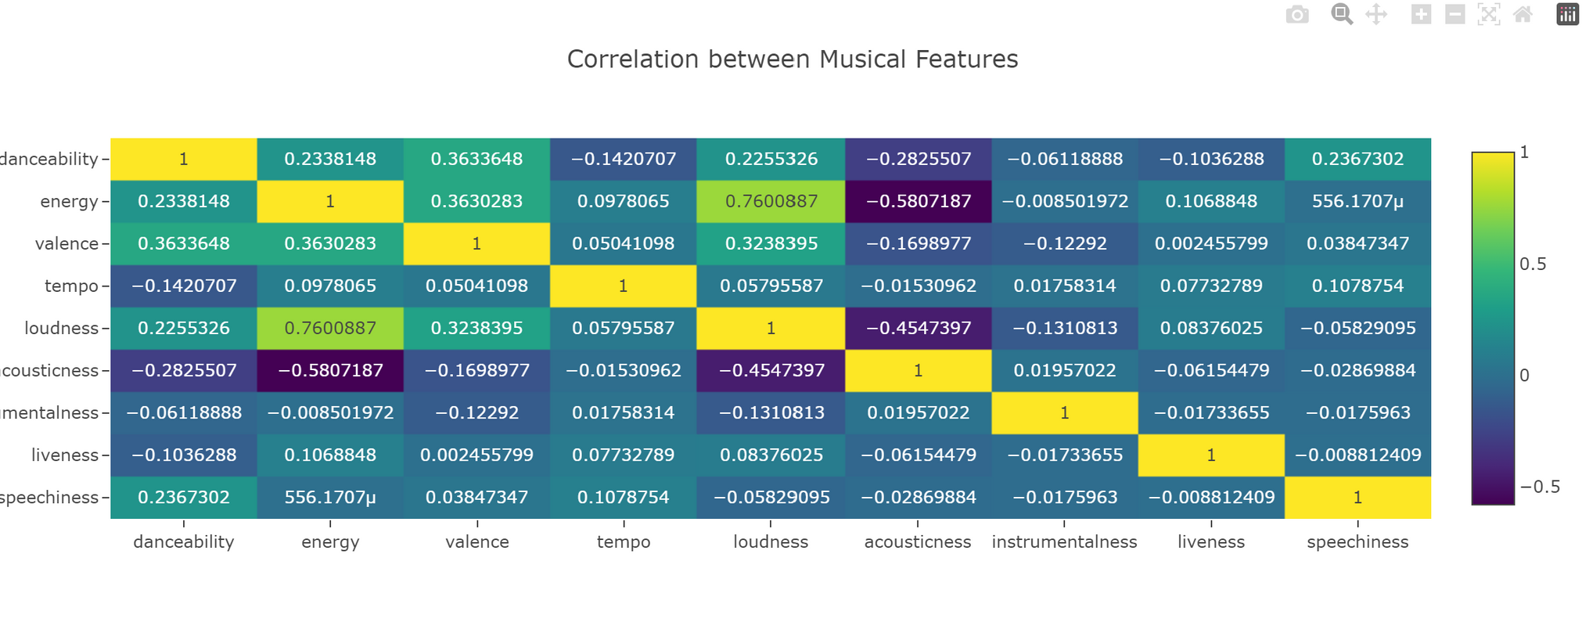
DATA VISUALISATION
Correlation between Musical features
We observed a robust positive correlation between loudness and energy, signifying that as the loudness of a song increases, its energy level tends to rise. Conversely, a negative correlation was identified between acousticness and energy, implying that as the acoustic nature of a track increases, there is a tendency for its energy level to decrease.

Slide 11
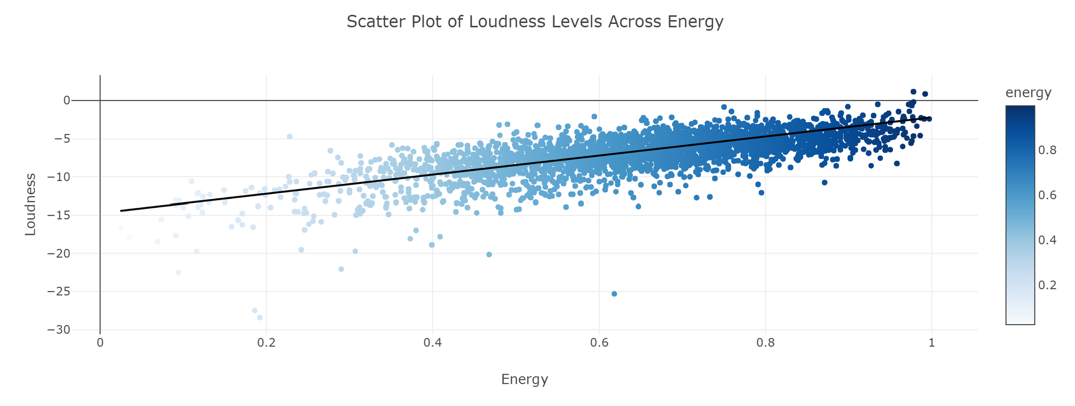
DATA VISUALISATION
Scatter Plot of loudness levels across energy
The relationship between loudness and energy is confirmed in this graph..
The mean loudness of the songs is -6.6 DB

Slide 12
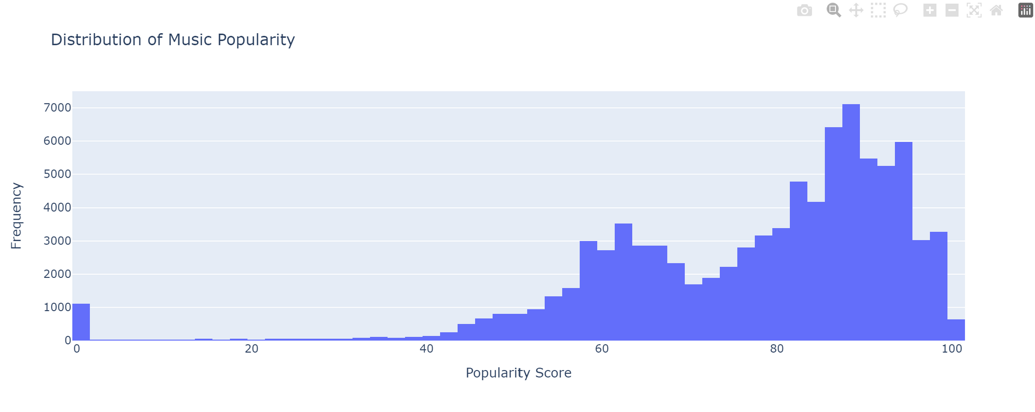
DATA VISUALISATION
Histogram - distribution of music popularity
More the music is listened frequently more it is popular.

Slide 13
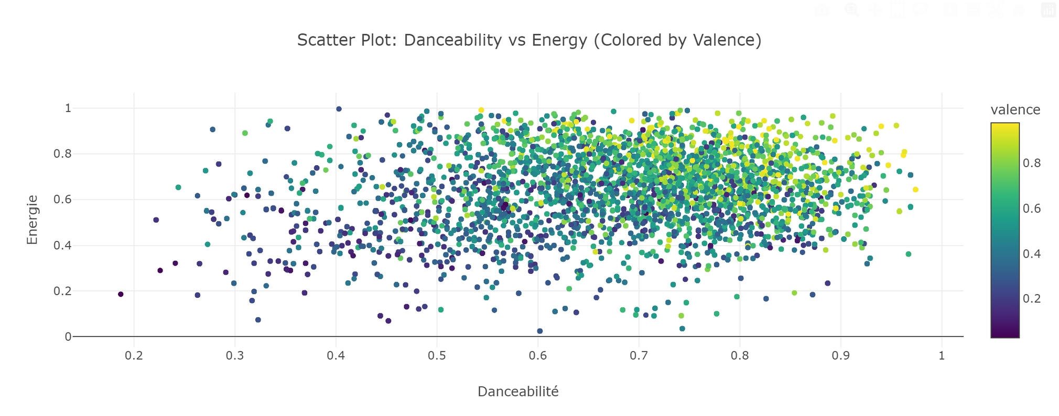
DATA VISUALISATION
Scatter Plot: Danceability vs Energy (Colored by Valence)
A distinct cluster is evident in the data, indicating that high energy is associated with both high danceability and valence. Additionally, outliers in the data may represent exceptional songs deviating significantly from the overall trends.

Slide 14
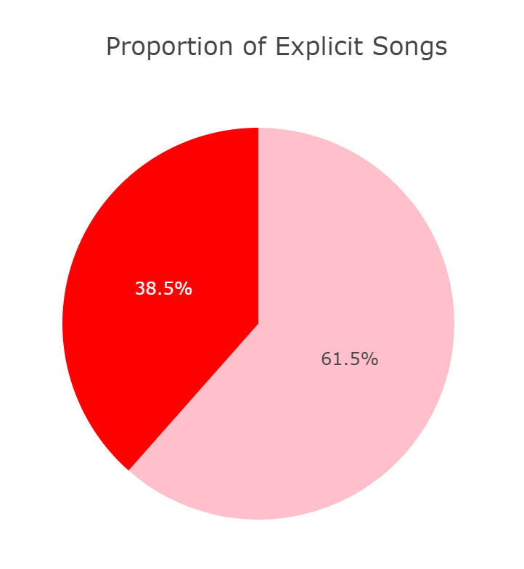
DATA VISUALISATION
Pie Plot - Proportion of Explicit songs
In red we have the proportion of explicit song and in pink the non explicit songs.

Slide 15
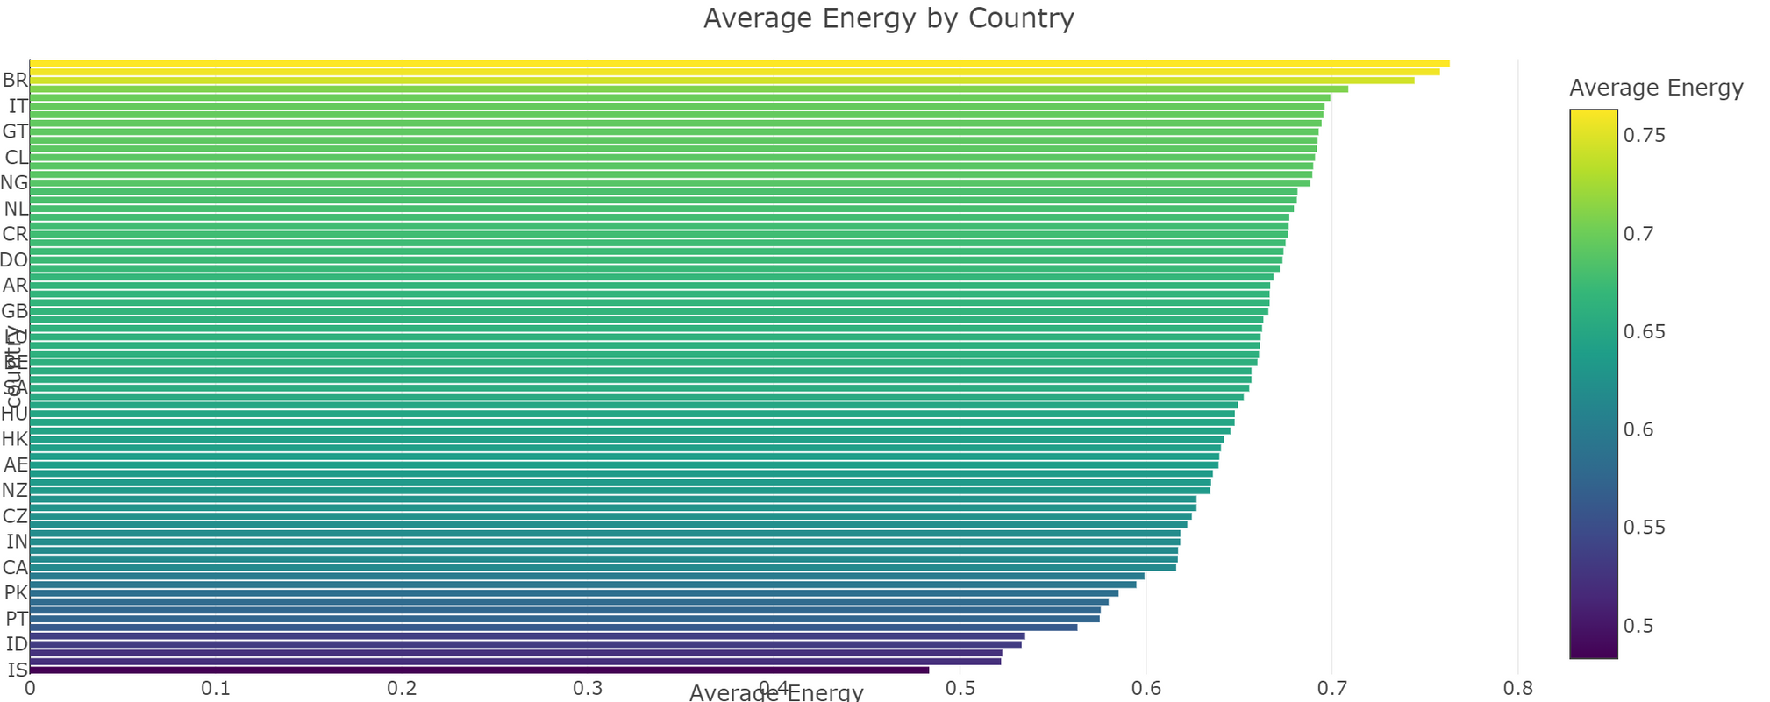
DATA VISUALISATION
Average Song Energy by Country
We can see that some country have more energetic songs than others ! Like Bulgaria, Japan, Brazil compared to Iceland, Israel, Vietnam.

Slide 16
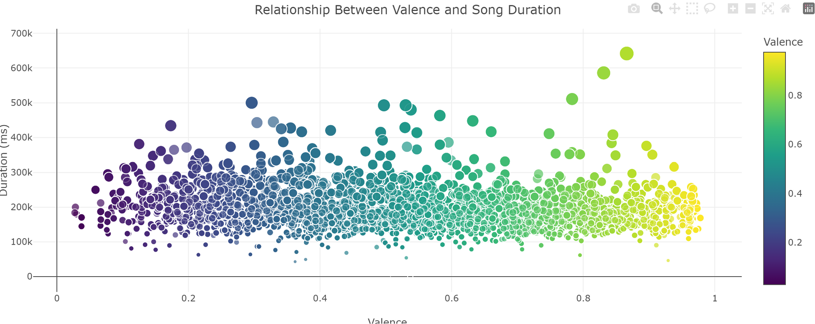
DATA VISUALISATION
Relationship Between Valence and Song Duration
"Valence" is an emotional dimension describing the mood of a musical piece, with a valence near 0 indicating a sad or melancholic mood, while a valence approaching 1 represents a happy and positive mood. The graph suggests that there is no significant relationship between valence and the duration of the song.

Slide 17
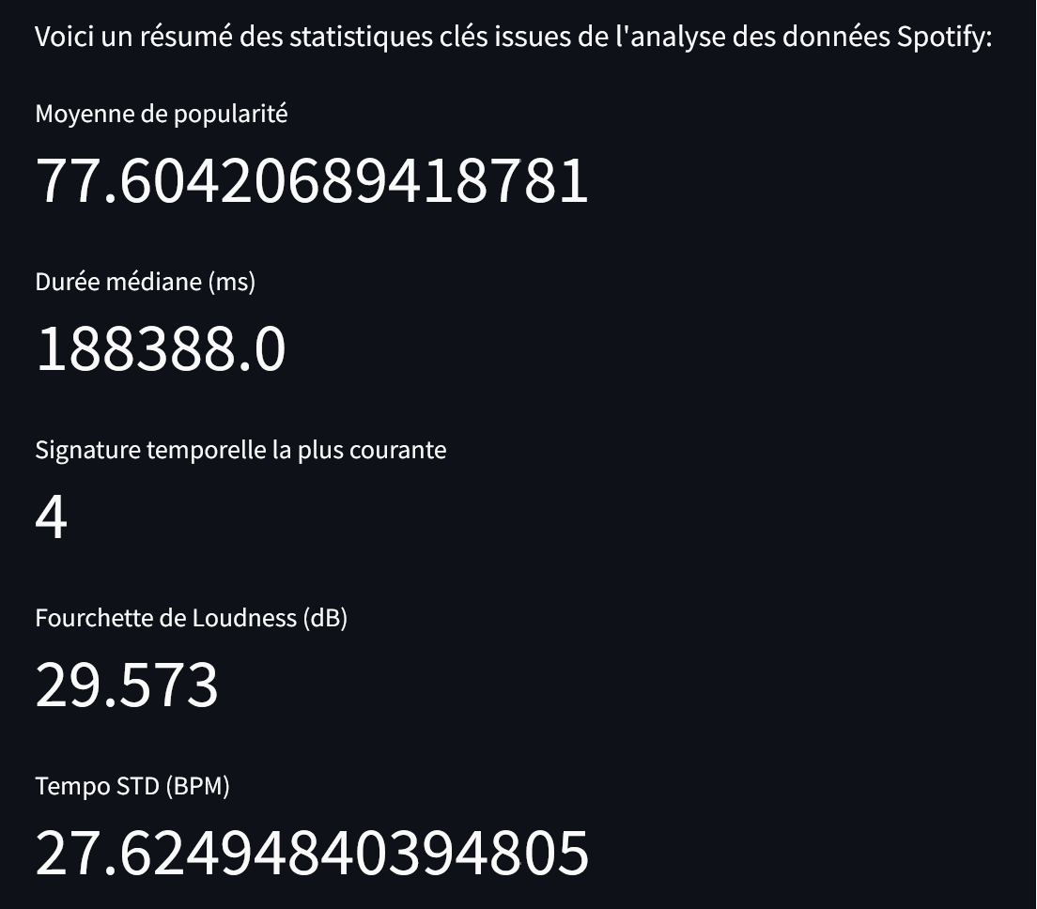
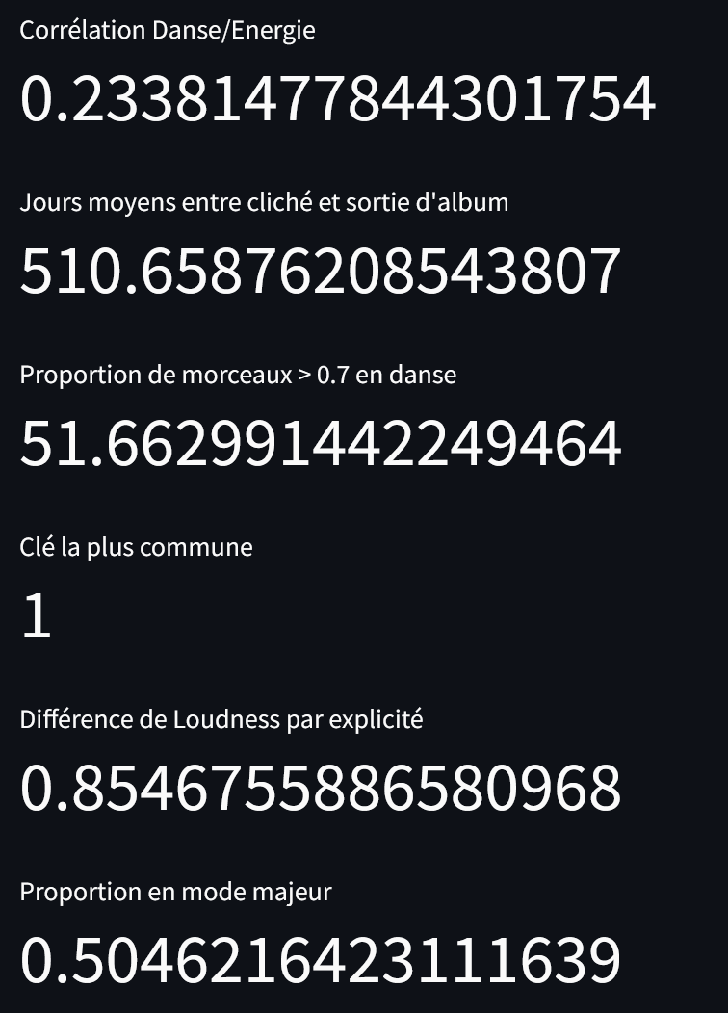
DATA STATISTICS

Slide 18
STREAMLIT
3 problematics :
Data processing managment
Hosting ML algorithm
Calcul optimisation integrated in a website
Website components
3 pages : Home, stat, visualisation
6 sliders
Expositions of dataframe

Slide 19






Data Loading managment
STREAMLIT
Spotify data
Geo Json data
Library optimisation
Plotlib express library
Scipy stat + Random Forest
Hosting server managment
Streamlit code
Hosting on heroku server
Container of the application

Slide 20
THANK'S FOR LISTENING

